Slide 1

Machine Learning-Based Fraud Detection
Identifying Suspicious Banking Transactions in Real Time
AI · FINANCIAL SECURITY · ML

Slide 2

The Growing Fraud Threat in Digital Banking
Over 500 million digital transactions are processed daily worldwide. Financial fraud costs the global economy an estimated $10.5 trillion annually by 2025. Traditional systems cannot keep pace with the speed, scale, and sophistication of modern fraud.
Evolving Fraud Patterns
Rule-based systems fail to detect novel attack vectors and emerging techniques
High False Positives
Legitimate transactions flagged, causing customer friction and operational overhead
Delayed Detection
Batch processing introduces critical delays, allowing fraud to compound
Manual Monitoring
Human analysts cannot scale to millions of daily transactions

Slide 3


Intelligent Detection: The ML-Powered Solution
The system ingests transaction records and classifies them in real time using advanced ML models. Each transaction is evaluated across multiple dimensions:
Transaction Profile
Behavioral Signals
Amount, frequency, time, and merchant category
Customer history, device fingerprint, and location anomalies
Risk Scoring
Alert Generation
Fraud probability score (0–100) assigned per transaction
Automated alerts with severity levels for immediate action

Slide 4
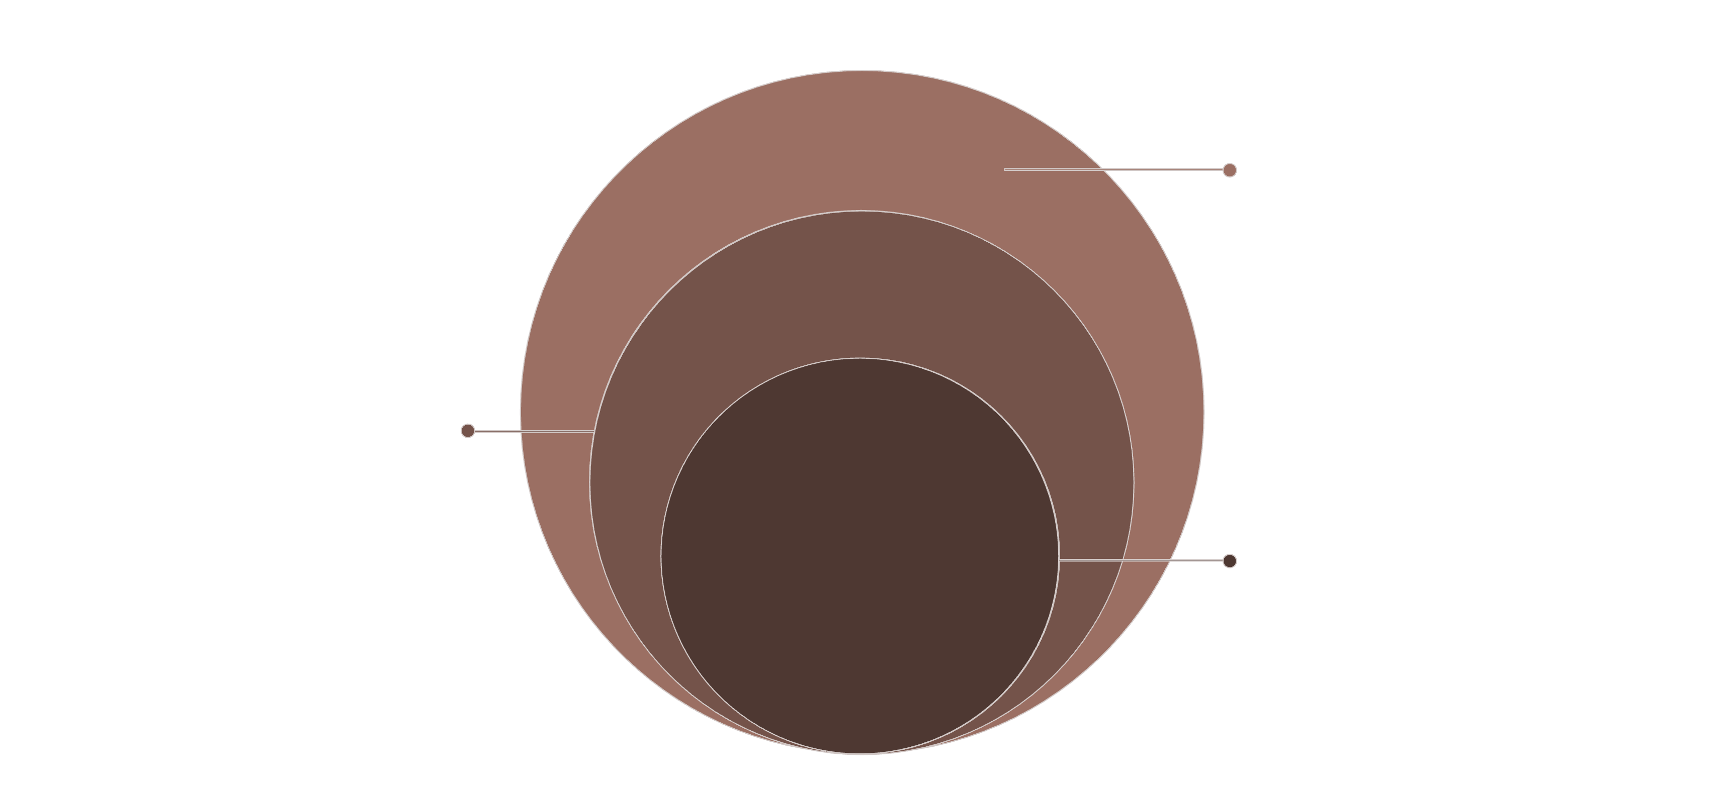
System Architecture
Outer: Data & Cloud
PostgreSQL, Redis, Data Lake, Kubernetes
Middle: Business & App
Transaction and Alert Management, REST APIs
Core: ML Prediction
Feature Engine, Fraud Model, Risk Scorer
The six-layer architecture ensures separation of concerns, scalability, and fault tolerance. The ML Prediction Layer operates independently, enabling model updates without disrupting transaction processing or user-facing services.

Slide 5

End-to-End Fraud Detection Workflow
Feature Engineering
Capture & Auth
Record transaction and authenticate
Extract signals for models
Validate & Prep
Model Inference
Cleanse and normalize data
Predict fraud probability
Each transaction is processed in under 200 milliseconds. The pipeline supports continuous learning — investigator feedback and new fraud patterns are fed back into model retraining cycles, ensuring the system adapts to evolving threats.

Slide 6

Machine Learning Model Pipeline
Algorithm Selection
Handling Class Imbalance
The system supports multiple classifiers, with XGBoost and LightGBM as primary models due to their performance on imbalanced financial data.
Fraud represents <1% of transactions. The system uses SMOTE oversampling, cost-sensitive learning, and anomaly detection to maintain high recall without inflating false positives.
Key Metric: ROC-AUC > 0.97 achieved on benchmark datasets using XGBoost with tuned hyperparameters.
Tree-Based
Linear & SVM
Neural Networks
Ensemble
Random Forest, XGBoost, LightGBM, CatBoost
Logistic Regression, Support Vector Machine
Deep Learning, Autoencoders, LSTM
Stacking, Voting, Gradient Boosting

Slide 7
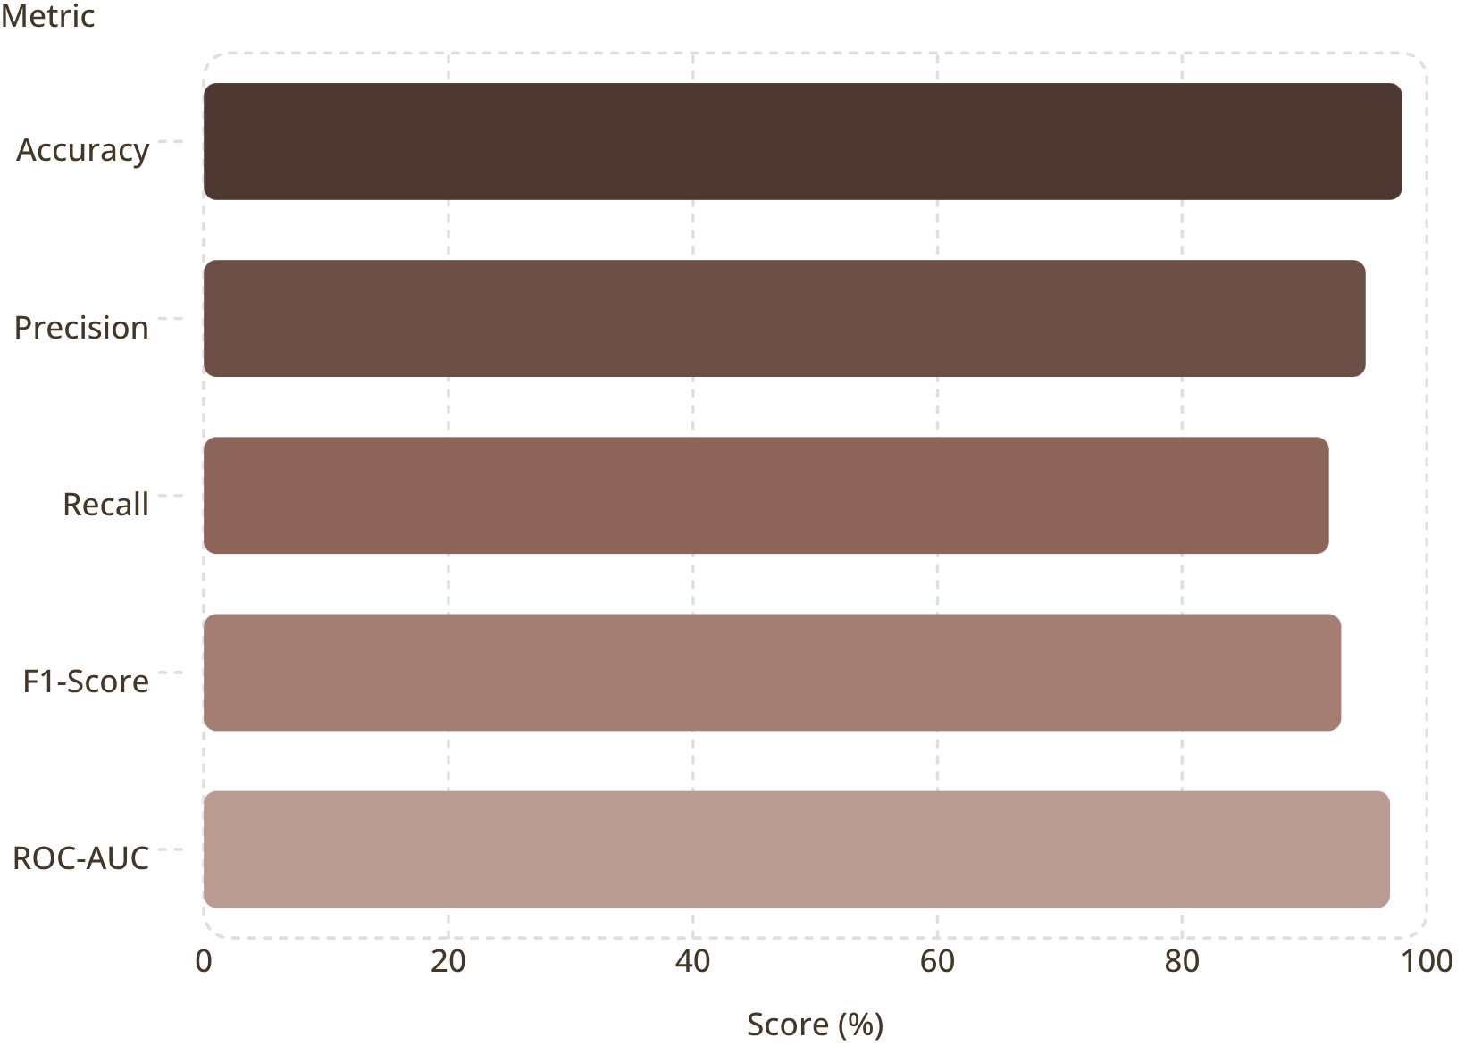
Model Performance & Evaluation
Interpreting the Metrics
Recall (92%) ensures most fraud is caught. Precision (95%) minimizes false positives, reducing customer friction. The F1-Score (93%) balances both concerns.
Confusion Matrix: Validates true/false positive and negative rates
ROC-AUC (97%): Strong discrimination between fraud and legitimate transactions
Detection Latency: Under 200ms per transaction in production

Slide 8






Technology Stack
Frontend
Backend
React.js, Angular, D3.js, Chart.js for real-time dashboards and responsive UI
Python (Flask/FastAPI), Node.js, Spring Boot for REST APIs and microservices
Data Layer
ML Framework
PostgreSQL, Redis, Apache Kafka, Elasticsearch for transactional and analytical storage
Scikit-learn, XGBoost, TensorFlow, PyTorch, MLflow for model training and serving
Cloud & DevOps
Security
AWS/GCP, Kubernetes, Docker, Terraform for scalable, containerized deployment
OAuth 2.0, JWT, AES-256 encryption, TLS 1.3, RBAC for data protection and compliance

Slide 9
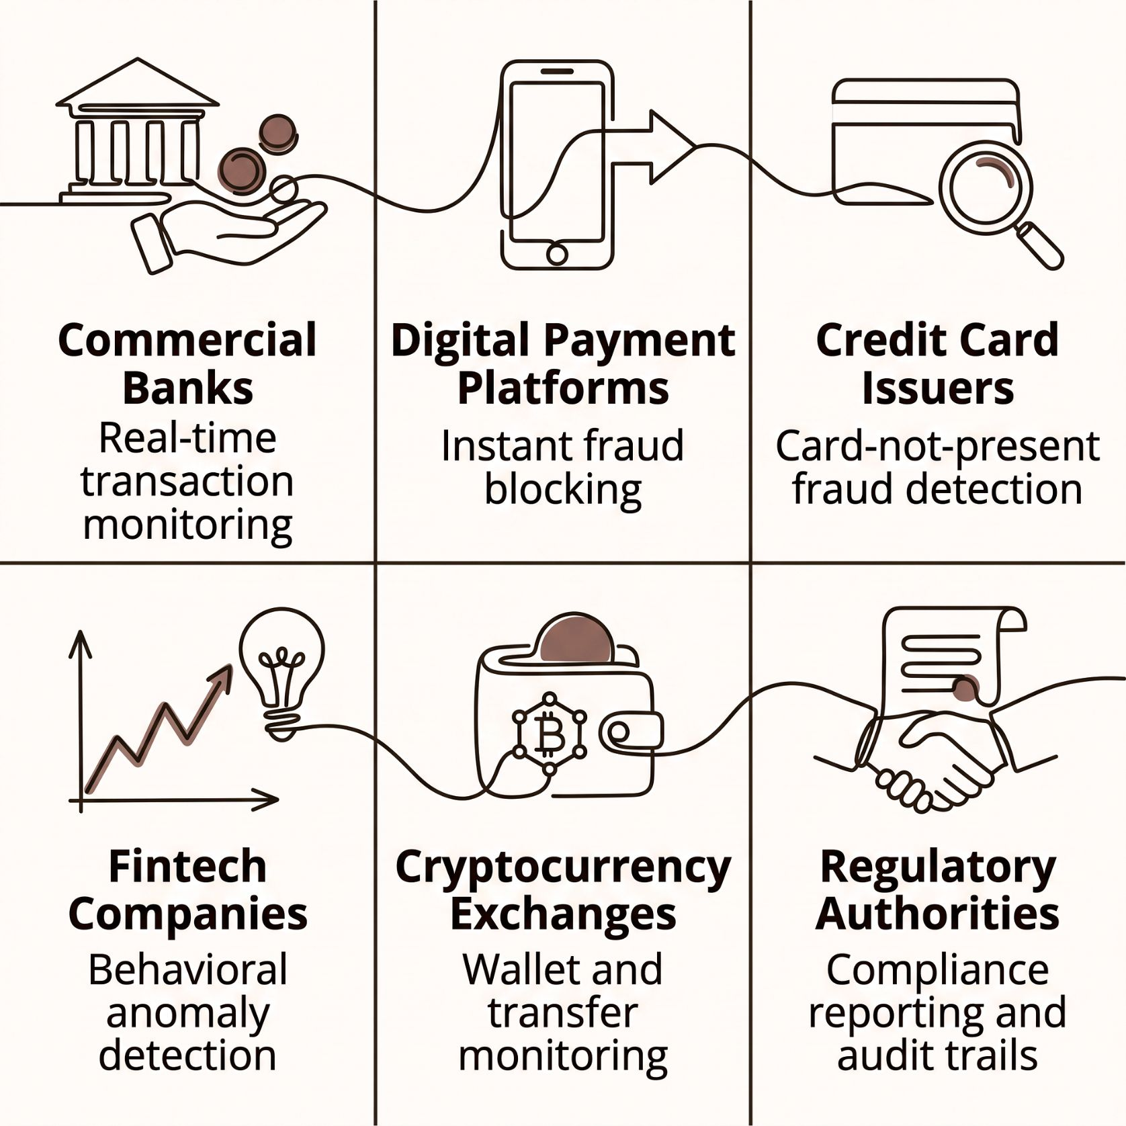

Real-World Applications & Key Advantages
Core Advantages
Real-Time Detection
Reduced False Positives
Sub-second fraud identification at transaction level
ML precision minimizes legitimate transaction blocks
Regulatory Compliance
Scalable Deployment
Audit logs, reports, and controls for RBI, PCI-DSS, GDPR
Cloud-native architecture handles millions of TPS

Slide 10


Challenges & The Road Ahead
Current Challenges
Highly imbalanced fraud datasets
Emerging fraud techniques & adversarial attacks
Legacy system integration complexity
Data privacy & regulatory compliance
Future Enhancements
Graph Neural Networks for fraud relationship mapping
Explainable AI for transparent decisions
Federated Learning for privacy-preserving training
Behavioral biometrics & blockchain integration
Conclusion: This ML-powered system delivers real-time, intelligent fraud detection — reducing losses, strengthening security, and enabling scalable, compliant operations for modern financial institutions.

